Slide 1
Best location for a Mexican Restaurant
Applied Data Science Capstone
IBM Data Science Professional Certification
IVAN EDMUNDO DE LA ROSA MONTERO

Slide 2
Problem
While opening a restaurant can be a very lucrative business, a lot of factors cause many restaurants to close within the first year of opening.
Factors for Restaurant’s Success: Location, Competition, Quality of Food
Business Problem: If the client wanted to open an Mexican Restaurant in Toronto, what areas are the best options to open the restaurant?

Slide 3





Data
Data Sources:
Foursquare API
Toronto Census
Toronto PostalCode
Population & Ethnic Distribution of Each Neighborhood (Toronto Census)
Income Distribution of Each Neighborhood (Toronto Census)
Number of Restaurants in Each Neighborhood (Foursquare API)
Number of Mexican Restaurants in Each Neighborhood (Foursquare API)
Latitude and Longitude of Each Neighborhood

Slide 4
Problem

Slide 5
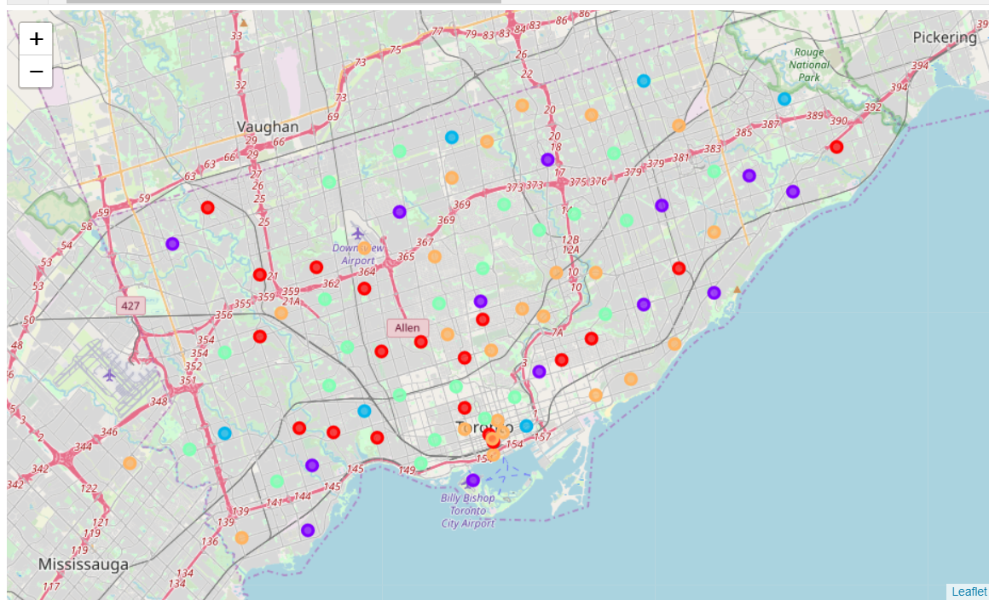
Foursqaure API
Cluster 0 = Red Cluster 1 = Purple Cluster 2 = Blue Cluster 3 = Turquoise Cluster 4 = Orange

Slide 6
Cluster | Characteristics
Cluster 0 | Negative Spending Power (-1.1- -0.4)
Cluster 1 | Positive Spending Power (0.2 - 1.8)
Cluster 2 | High Positive Spending Power (1.8 - 3.8)
Cluster 3 | Near Zero Spending Power (-0.4 - 0.5)
Cluster 4 | Near Zero Spending Power (-0.8 – 0.2)

Slide 7
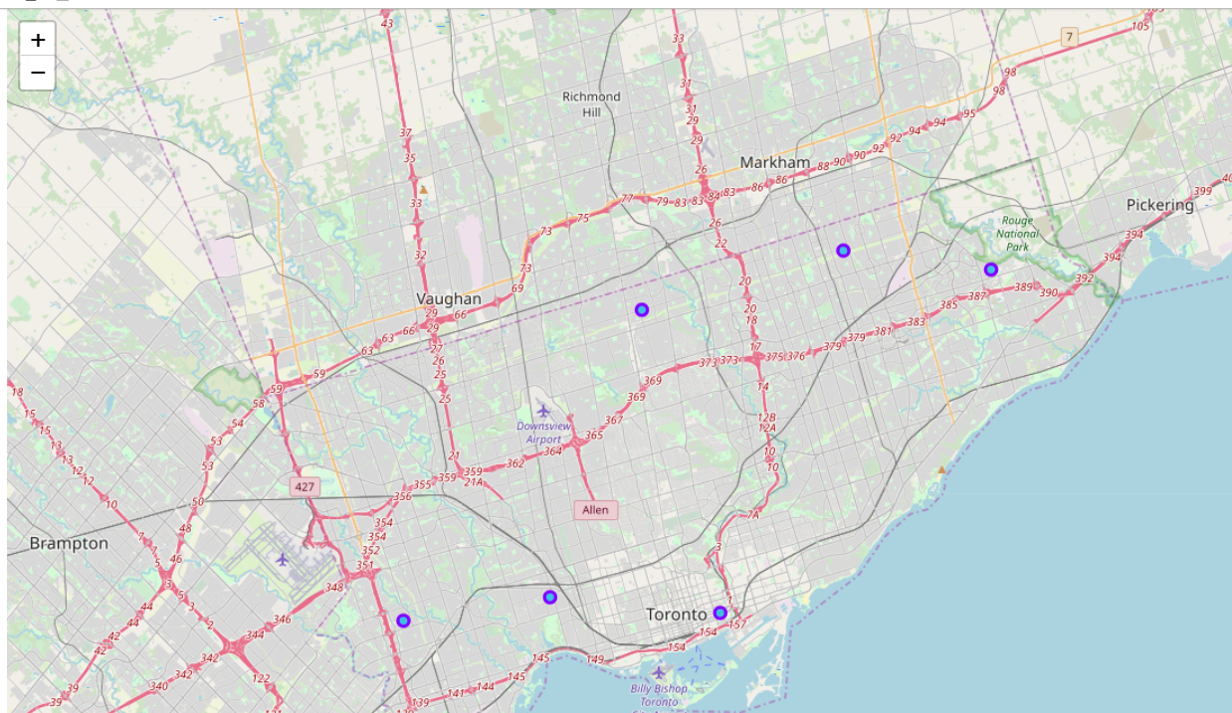

Slide 8
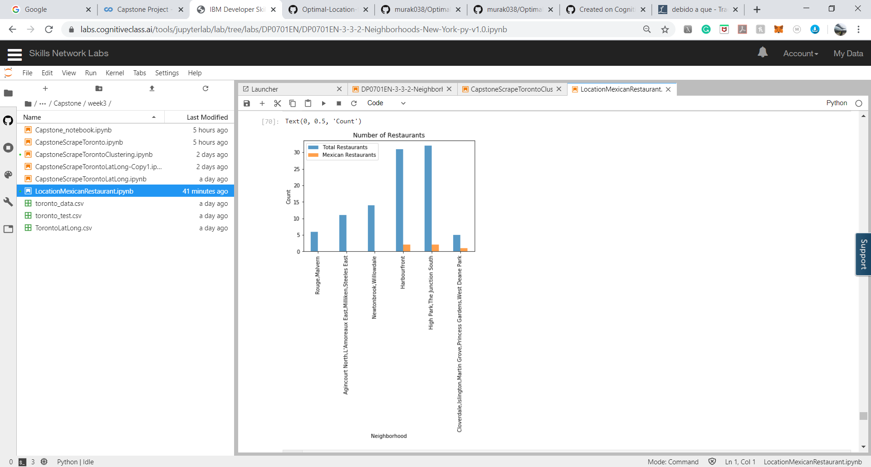
From the plot, the following areas can be eliminated due to the large number of areas:
High Park, The Junction South region
Cloverdale, Islington, Martin Grove, Princess region
Harbourfront

Slide 9
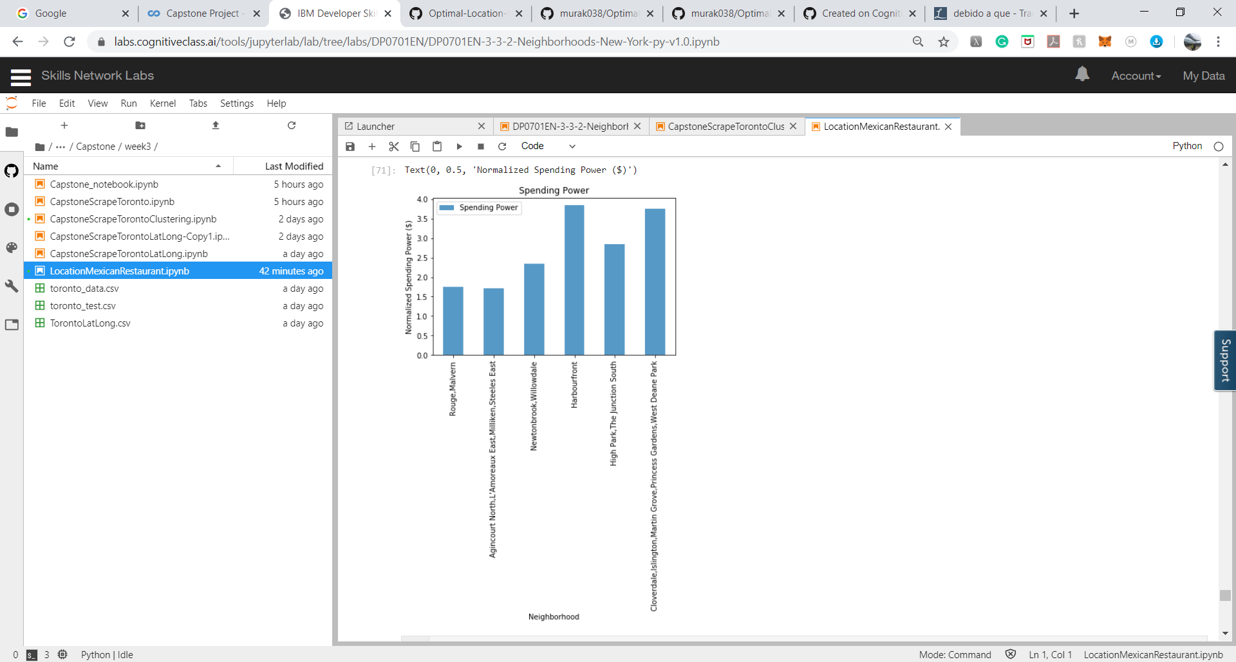

Slide 10
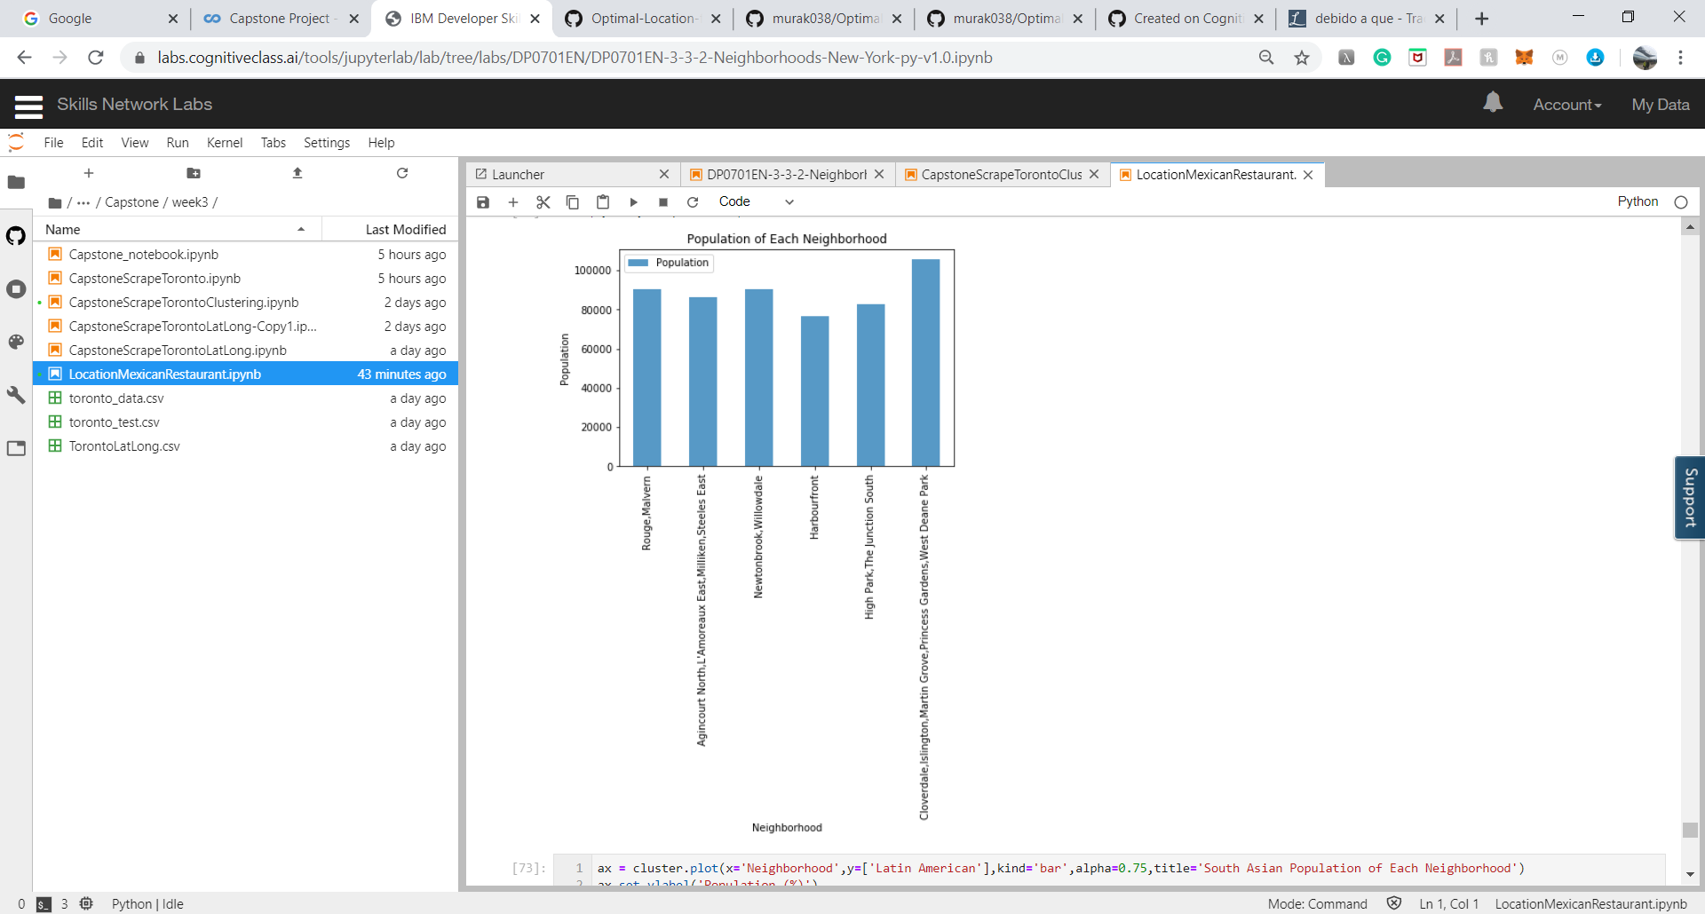
The population of each region is relatively the same.

Slide 11
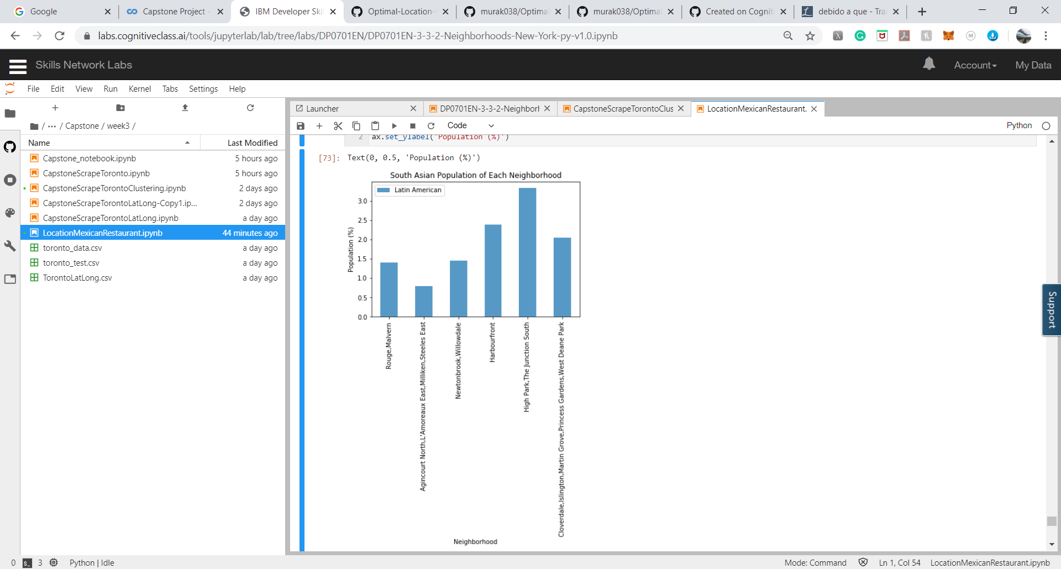
either the Rouge, Malvern region or Newtoonbrook, Willowdale region has the highest percentage of Latin Americans of the selected regions and thus the demand will be higher.

Slide 12
Conclusion
The optimal location to open a Mexican restaurant in Toronto should be either the Rouge, Malvern region or Newtoonbrook, Willowdale region.

Slide 13
Thank you!

